Slide 1


PREDICTING SIMPSONS CHARACTERS
Team Members:
P.Mrudula Devi
Ch.Madhuri Yadav
P.Yashoda Rishita
D.Niharika

Slide 2
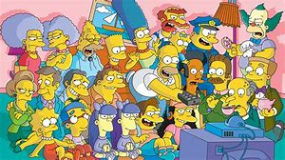
Introduction
The Simpsons is an American animated sitcom created by Matt Groening for the Fox Broadcasting Company. The series is a satirical depiction of working-class life, epitomized by the Simpson family, which consists of Homer, Marge, Bart, Lisa, and Maggie. The show is set in the fictional town of Springfield and parodies American culture and society, television, and the human condition.

Slide 3
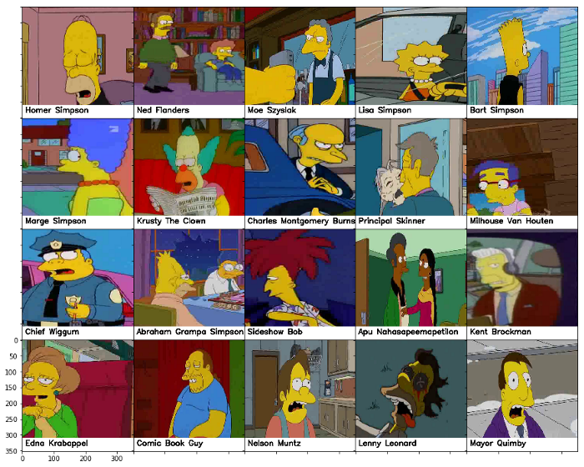
Since its debut on December 17, 1989, 662 episodes of The Simpsons have been broadcast. It is the longest-running American sitcom, and the longest-running American scripted primetime television series in terms of seasons and number of episodes. The Simpsons Movie, a feature-length film, was released in theaters worldwide on July 27, 2007, and grossed over $527 million. Then on October 30, 2007, a video game was released. Currently, The Simpsons finished airing its thirtieth season, which began airing September 30, 2018. The Simpsons was renewed for a thirty-first and thirty-second season on February 6, 2019, in which the latter will contain the 700th episode.The Simpsons is a joint production by Gracie Films and 20th Century Fox Television and syndicated by 20th Television.

Slide 4
Objective
Our main objective of the project is to train a convolutional neural network(CNN) in such a way that it will recognize and predict the simpsons characters using Keras.

Slide 5
Techniques and Tools
We used python syntax for this project.
As a framework we used keras which is a high level neural network API written in python.

Slide 6
Convolutional Neural Networks
Convolutional neural networks(CNN) is a special architecture of artificial neural networks. It was proposed by Yann Lecun in 1988. CNN uses some features of the visual context. One of the most popular uses of the architecture is image classification , prediction of images etc.

Slide 7
Process
We go through following phases for prediction of the characters
Model construction
Model training
Model testing
Model evaluation

Slide 8
Building image dataset
The dataset is downloaded from Kaggle.The dataset currently features 18 classes/characters (the data on Kaggle contains 20 classes, but currently we used only 10 characters for training). The pictures are under various size, scenes, could be cropped from other characters and are mainly extracted from episodes.
The training set includes about 1000 images per character.

Slide 9
Preprossesing
The first step for preprocessing pictures is resizing them. We need to have all pictures with the same size for training.
Then, instead of characters name, we use numbers and using Keras, We can quickly convert those categories to vectors.

Slide 10
Training the model
We took 10 characters and implemented 80% for training and 20% for testing.
We took 13 epochs with batch size 30 and trained using CNN model in Keras.

Slide 11
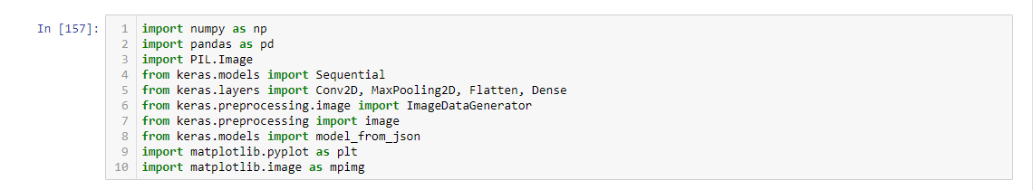
Required libraries:

Slide 12
Result
As a result of testing the model,we got a good accuracy of correct classification samples after 13 epochs.
Both training and testings models got succeeded and the tested image is predicted correctly.

Slide 13
Conclusion
In this work, I figured out what is deep learning. I assembled and trained the CNN model to predict the simpsons characters. I have tested that this model works really well with a small number of photos. I measured how the accuracy depends on the number of epochs in order to detect potential overfitting problem. I determined that 5 epochs are enough for a successful training of the model.

Slide 14
References
https://medium.com/alex-attia-blog/the-simpsons-character- recognition-using-keras-d8e1796eae36
https://simpsons.fandom.com/wiki/Category:Characters

Slide 15
Thank you

